Slide 1

Augmented Reality

Slide 2
What is Augmented Reality

Slide 3
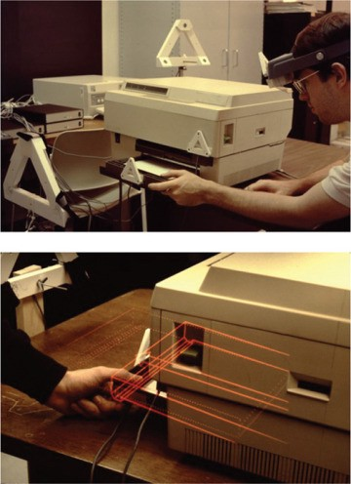
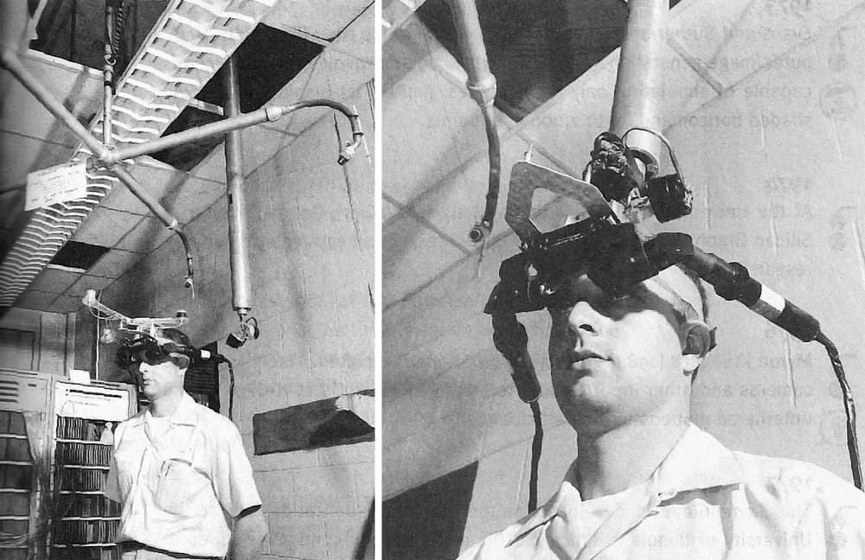
History of Augmented Reality
VR and AR were born! As theoretical concepts. It took a couple of decades for technology to catch up, and in the 1990’s AR found itself real-life applications for assisting workers with indoors assembly and maintenance.

Slide 4

Difference between AR and VR

Slide 5
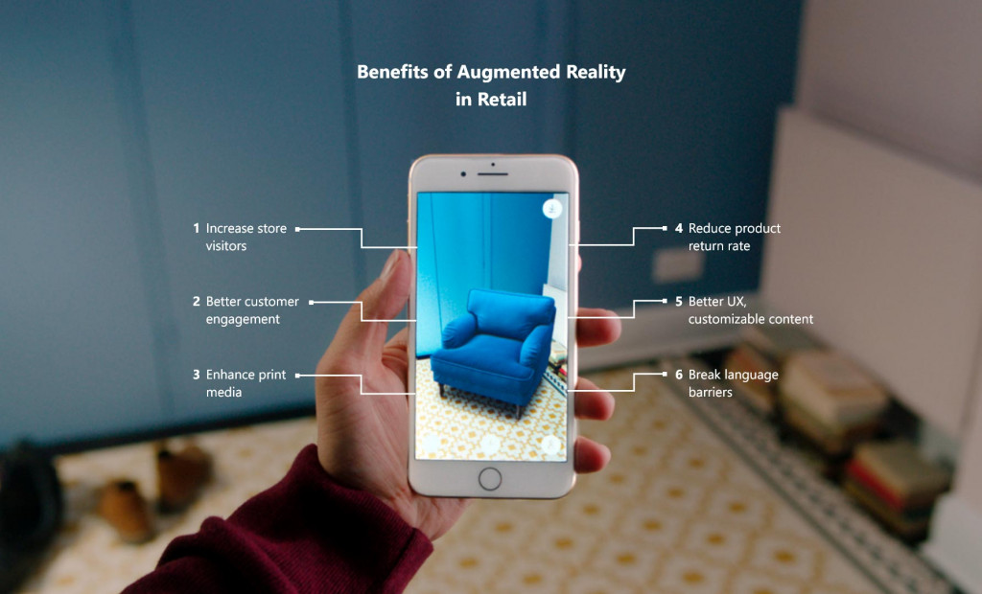

Slide 6
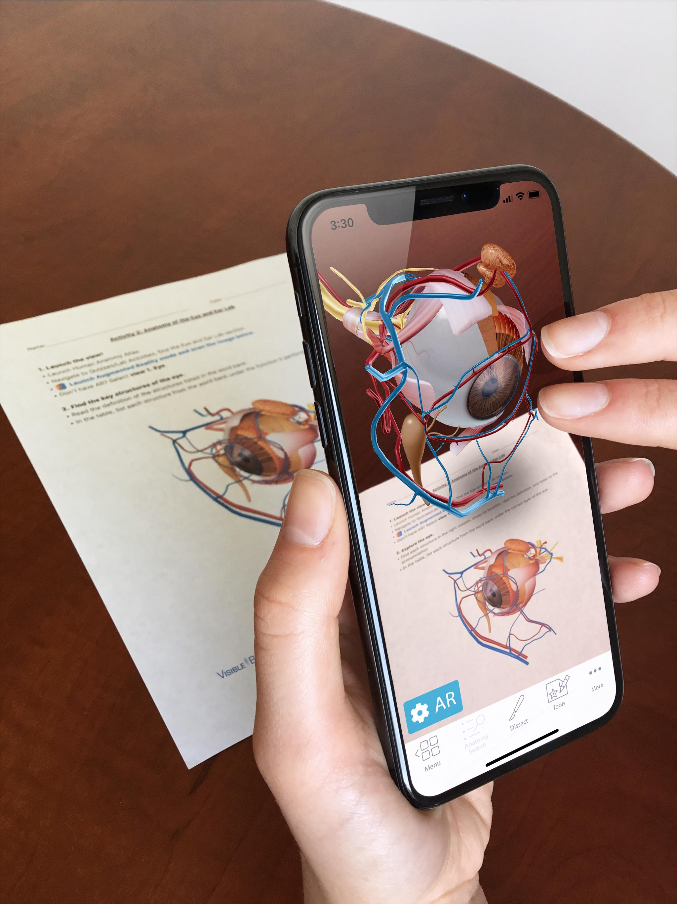
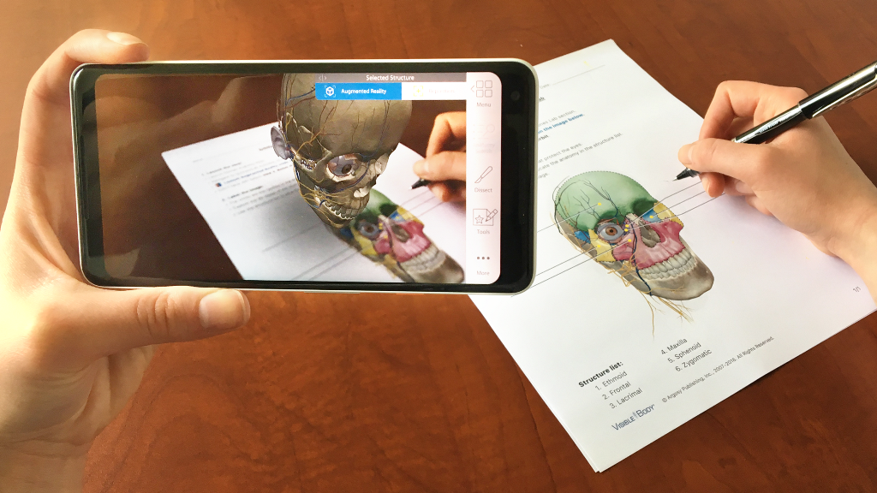
AR Use In Real World
1. Medical Training

Slide 7
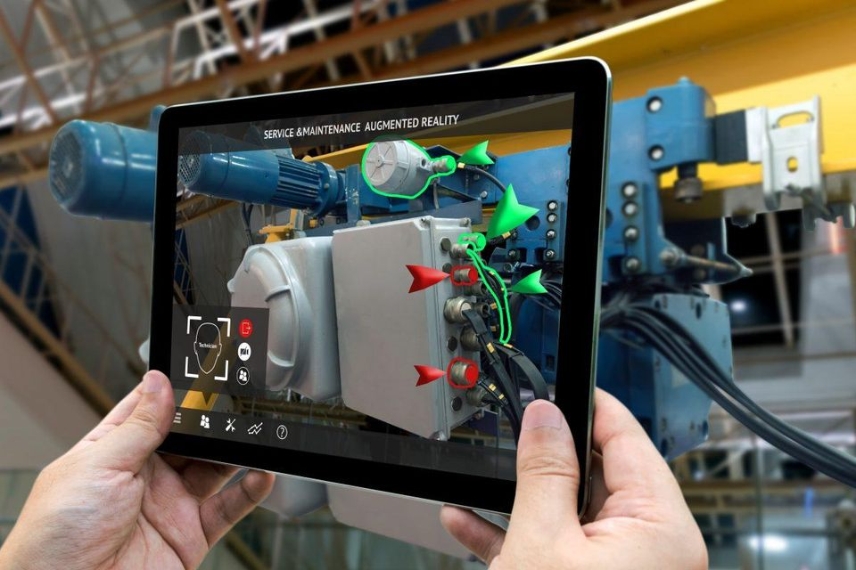
2. Service & Maintenance

Slide 8
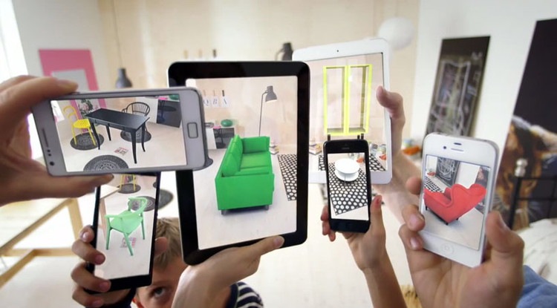
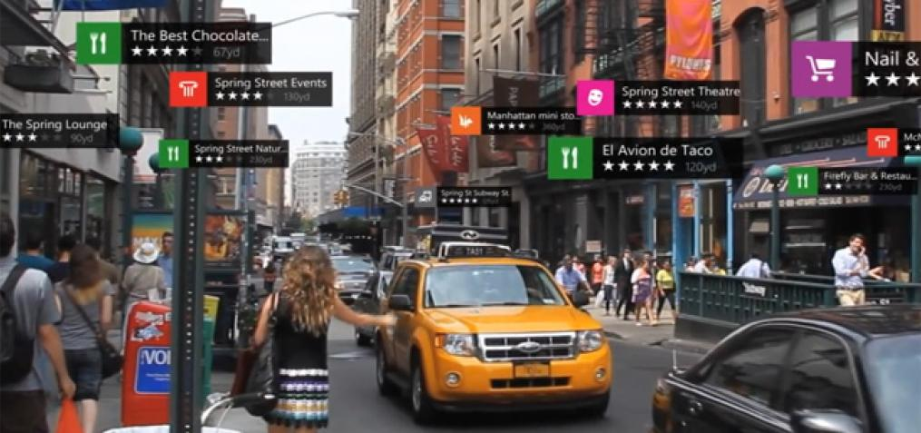
3. Business
4. Tourism Industry

Slide 9
Famours AR Apps in the world.

Slide 10
Tank you.

